Slide 1
Simpler. Faster. Better. Safer.
Notes:
Table of contents:
PayPal
History
The Biggest Payment system
Demographics
Paypal and the global market of payment services
Features for regular customers
Features for businesses
Demo
Questions?

Slide 2
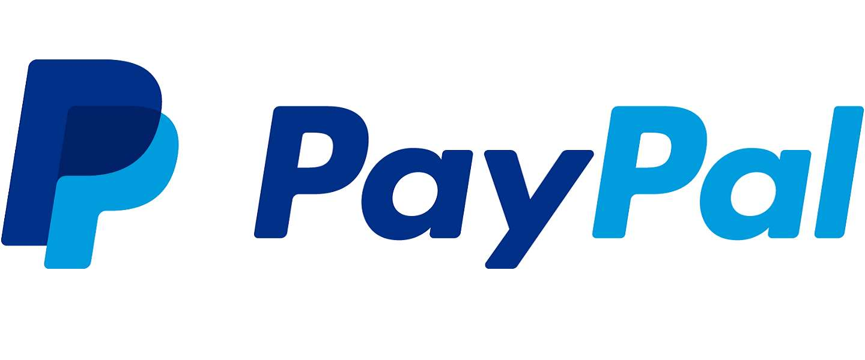
Notes:
//Wat is paypal in het kort.
//331 200 000 000 is over paypal gegaan (geconverteerd naar dollar)
In 1999 PayPal was voted one of the years 10 worst business ideas
PayPal provides an easy and quick way to send and request money online. You can transfer money (abroad) to family, friends, online shops, and auction sites like eBay.
Online payments
All you need to send money to family or friends is the email address of the recipient. By registering your credit card or bank account with your PayPal account you can send payments using the option Send and Request Money. The money will be credited to the recipient's account and can then be transferred to a bank account, or used to make a payment.
If you shop online and see the PayPal logo on the merchant's website, it means you can pay using PayPal. Just select PayPal at the checkout. You will be asked to log in to your account and confirm the payment. Your financial information will never be visible to sellers or online shops.
To receive money online
Anyone can send money to you using your email address. Your email address is linked to your personal PayPal account. You will receive an email notification whenever you receive a payment and the payment will be shown on your account.
Online shops that offer PayPal as a payment option can post the PayPal logo on their website. There are various ways to offer PayPal as a payment option, like Pay Now and Shopping Cart.
If you receive a payment through PayPal, we'll send you a notification by email. The money will be credited to your PayPal balance. You can transfer the money to your bank account or use it to make a payment yourself.

Slide 3
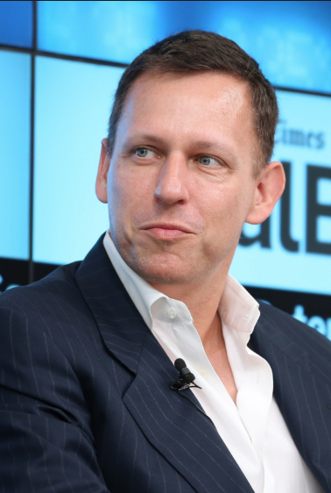
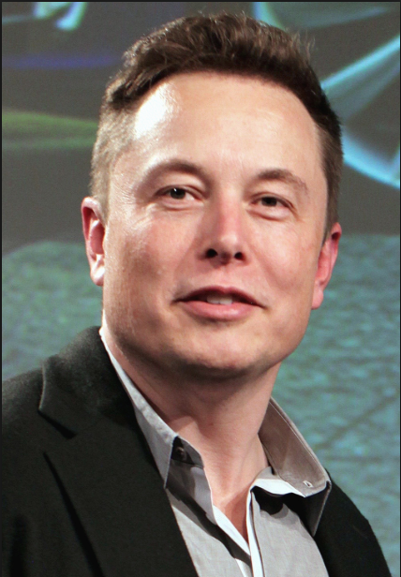
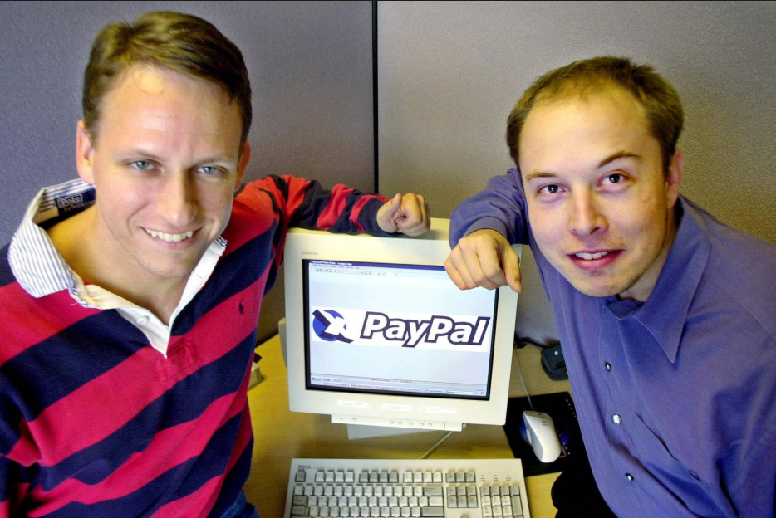
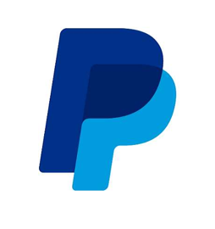
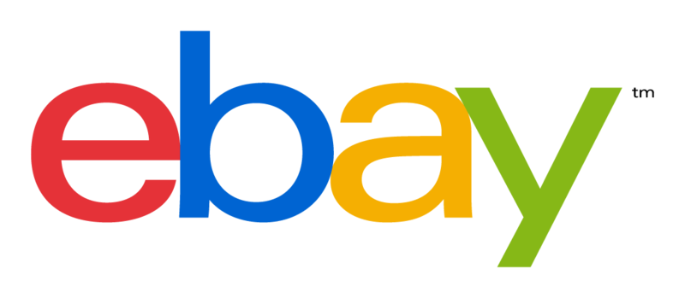
Notes:
Peter Thiel found Confinity 1998
Musk found X.Com 1999
Merge in March 2000
Renamed to PayPal 2001
Acquired by Ebay 2002
PayPal werd de betaalmethode die door een meerderheid van eBay-gebruikers werd gebruikt (het was ook de standaardkeuze), en de service concurreerde met eBay's dochteronderneming Billpoint, evenals Citibank's c2it, Yahoo!'S PayDirect, Google Checkout en de BidPay-service van Western Union , die allemaal in de daaropvolgende jaren zijn gesloten.
Splitsing 2015
Stopt als default payment method van ebay in 2020

Slide 4

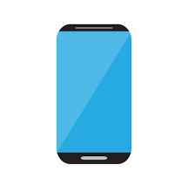


Biggest online payment system
Notes:
- 254 million active users
- 7.6 billion payment transactions
- Every second they processes more than 8000 dollar in payments
- Annual amount of payments made by mobile users is $1.2 billion
- 30% of all PayPal transactions are through the mobile application

Slide 5



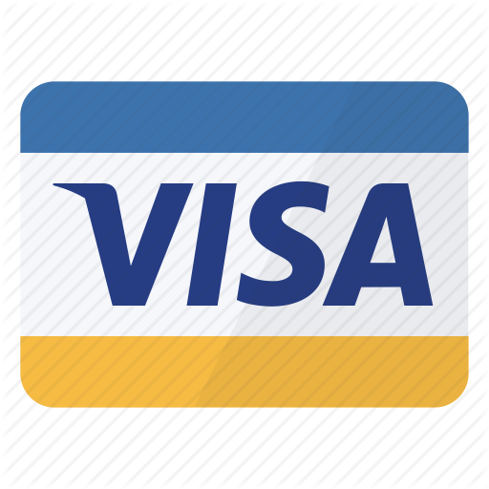
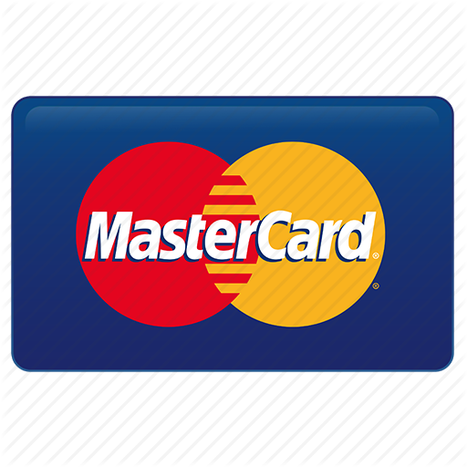

Biggest online payment system
Notes:
- The biggest online payment option.
- PayPal also has a lot of partnerships. For example with Google, Facebook, Visa, Master Card,...
86% percent PayPal customers are likely to recommend the service.

Slide 6


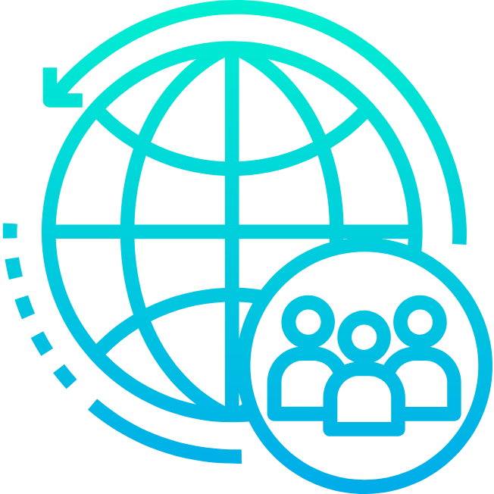
PayPal Corporation
Notes:
- 18000 employees worldwide
- 119 Nationalities
- 56% Male
- 44% Female
- 31 countries
- 56 offices

Slide 7
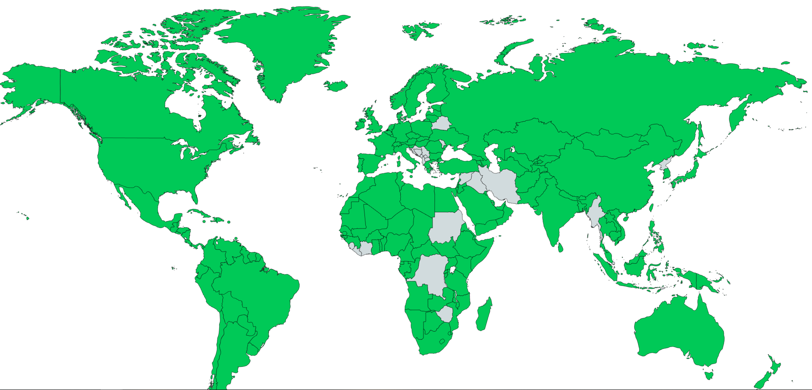
Notes:
- Easy for travelling, can be used in almost every country in the world
- 13 countries where you can't use PayPal as payment system
43% of the PayPal customers come from United States
Banned for business reasons

Slide 8
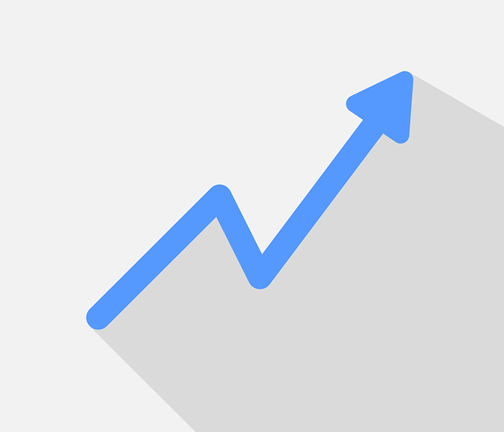
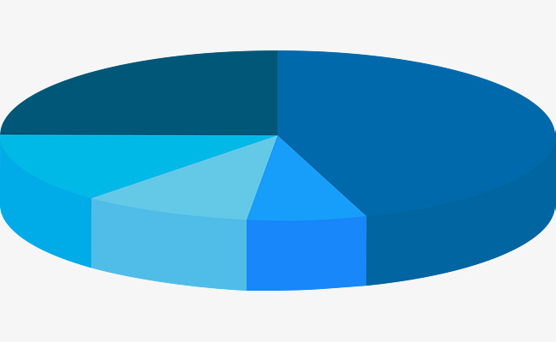
Market share
Notes:
- PayPal has 10% growth per annum comparing to other payment services with 3% grow.
- 18% of all e-commerce is processed by PayPal --> 331.200.000.000 dollar per annum -> around 331 billion dollar
- PayPal market share is 83%
- 87% of millennials (18 – 35 years old) use PayPal.

Slide 9
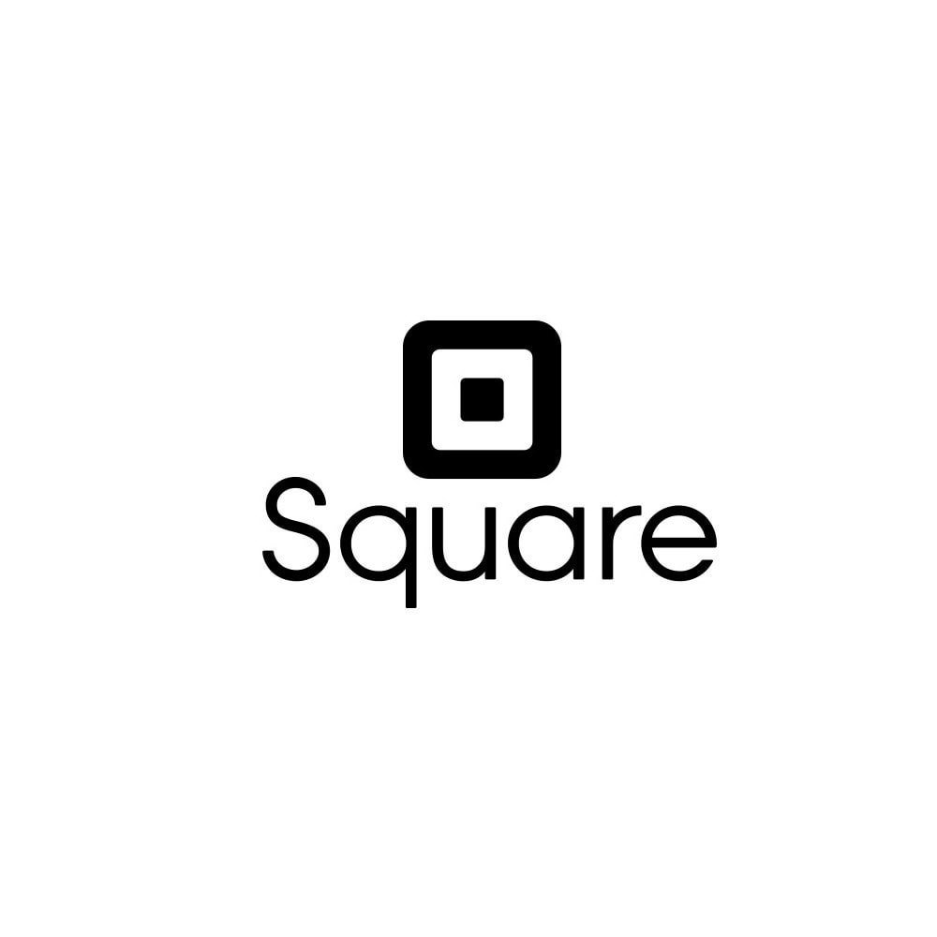
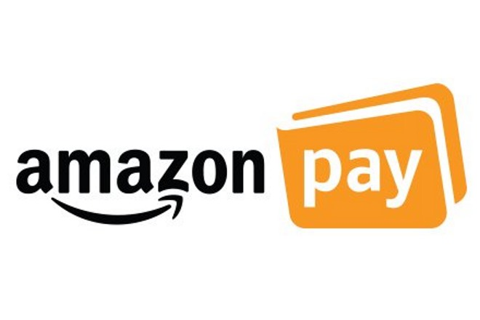



Notes:
PayPal has some small competitors:
- Authorize.net
- Square
- Klarna
- Amazon payment
- CC Bill
In total they only own 8.41% percent. PayPal owns the rest of the market
For me personally I only knew amazon payment.
And in

Slide 10

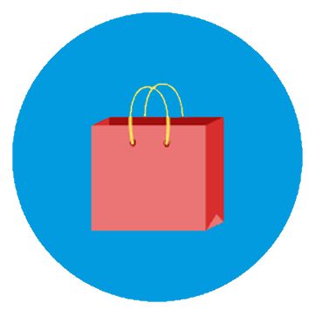


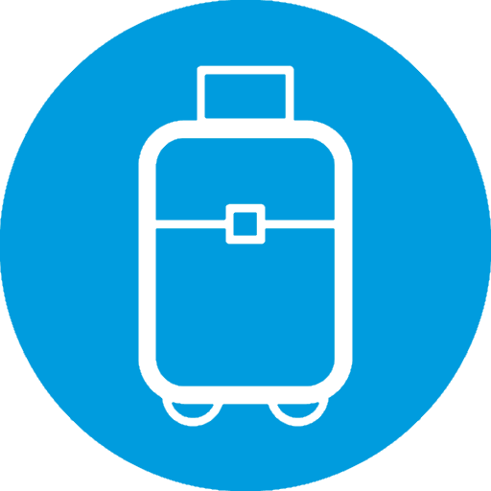


Industries
Notes:
Industries that use PayPal the most:
1: shopping
2 Business
Vehicles, technology, travel, entertainment and health

Slide 11
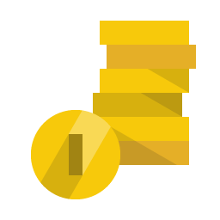
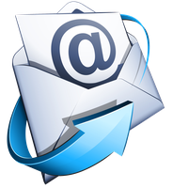


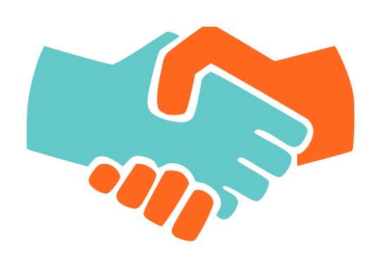

Features for private users
Notes:
Het enigste wat je nodig hebt, is een e-mailadres en wachtwoord
Veilig online betalen in meer dan 200 markten
Bedrag overmaken naar vrienden of familie is gratis
Er worden geen kosten in rekening gebracht bij afrekenen, tenzij bij valutaomwisselingen
Alle overschrijvingen worden versleuteld verzonden en je financiële gegevens zijn veilig opgeslagen zodat je deze nooit met andere hoeft te delen.
Je kan een creditcard of bankrekening koppelen aan paypal
Betaalverzoeken
OneTouch
Beschermd door aankoopbescherming
PayPal.Me

Slide 12

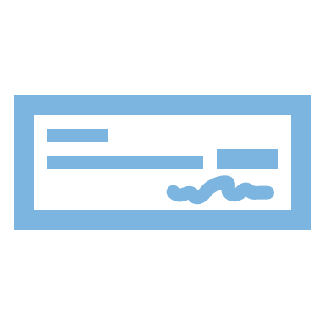


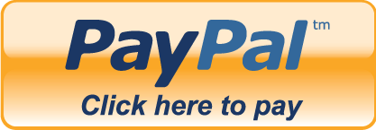
Business features
Notes:
Make Invoices
Seller Protection
Bulk payment (max 5000 people)
Detailed reports
Action centre (issues, messages)
Personal Payment Buttons

Slide 13

Notes:
UI reguliere rekening
Mogelijkheden reguliere rekening
UI zakelijke rekening
Mogelijkheden zakelijke rekening
Demo makkelijk overschrijven
Demo aankoop coolbue (Battle vs gwn bancontact)
Extra: Demo PayPal Button website voor developers

Slide 14
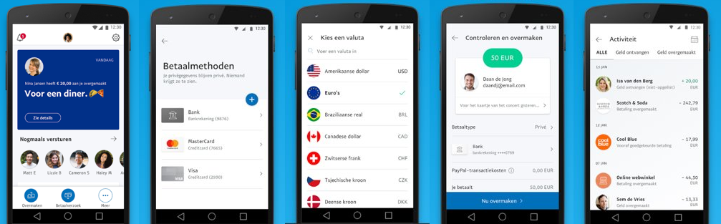
Mobile App

Slide 15

Questions?
Notes:
Bronnen:
https://www.paypal.com/stories/us/paypal-reports-1st-qtr-2017-results-raises-financial-guidance
https://www.alexa.com/siteinfo/paypal.com
https://www.paypal.com/us/webapps/mpp/about
https://www.siliconrepublic.com/companies/paypal-diversty-demographics-global-workforce
https://playnpay.co.uk/wp-content/uploads/2017/08/infographic-paypal-success-story-01-2.png
https://expandedramblings.com/index.php/paypal-statistics/
https://www.siliconrepublic.com/companies/paypal-diversty-demographics-global-workforce
https://trends.builtwith.com/payment/PayPal/Market-Share
http://www.hitwise.com/blog/2016/01/what-payment-options-do-online-shoppers-prefer/
https://venturebeat.com/2015/08/19/paypal-acquires-mobile-commerce-platform-modest-run-by-obamas-former-campaign-cto/
http://fortune.com/2016/10/20/venmo-20-billion/
https://finance.yahoo.com/news/7-fun-facts-paypal-pypl-161704951.html
http://www.pymnts.com/in-depth/2015/throwback-thursday-paypals-biggest-days-in-history/

